Slide 1

Stocks and Machine Learning in a Time of Covid
UCSD Data Science & Visualization
Jessica Nugent, Ivy TiongCo, Nick Theriot, Alexander Burch, EmilY akemann

Slide 2


Purpose: To use machine learning to predict stock behavior had the March 2020 stock market crash due to the global pandemic not happened
Source Data: yahoo finance

Slide 3
Background:
There was a large market crash in March 2020 due to fears surrounding the spread of Covid-19 and many countries around the world issuing stay at home orders
Due to wild speculation about the market’s recovery and low rates of return in typically “safe” investments like bonds, there has been an unprecedented rush of money into the market.
Tech, online education, e-commerce, and grocery stocks have benefitted the most being for the most part unaffected by stay at home orders, however EV (electric vehicle) stocks like Tesla have also had an army of new investors rush in.
Stocks that have also seen a lot of volatility and have yet to recover since the crash include travel-related stocks like airlines and cruises, as well as oil which at the same time had a price war between Russia and Saudi Arabia.

Slide 4
Using Machine Learning to Answer “What If”:
We chose the LSTM Long-Short-Term Memory Recurrent Neural Network as our machine learning model.
Popular for time-series forecasting for classification, processing, and making predictions.
We used two years of individual stock closing price data from July 2, 2018 – July 9, 2020.
We trained and tested the LSTM model on data up to December 19, 2019.
We predicted the stock prices after December 19, 2019 with the already-trained LSTM model.
We plotted the predicted stock prices against the actual prices for that time period to visualize the model’s accuracy.

Slide 5
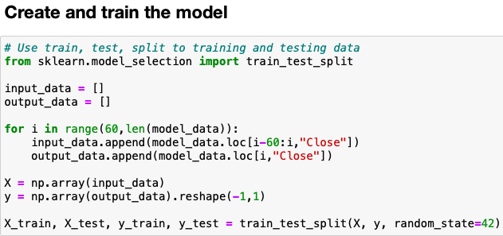
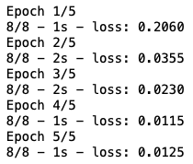
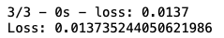
Training and Testing
Training Loss
Testing Loss

Slide 6
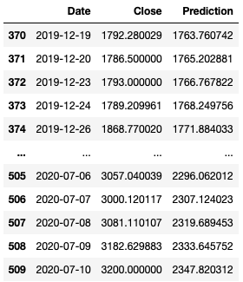
Predicting 2020 Stock Prices
Our model did a good job of predicting the trends in stock prices.
One limitation is that we weren’t able to predict stock prices without using the actual closing prices.

Slide 7
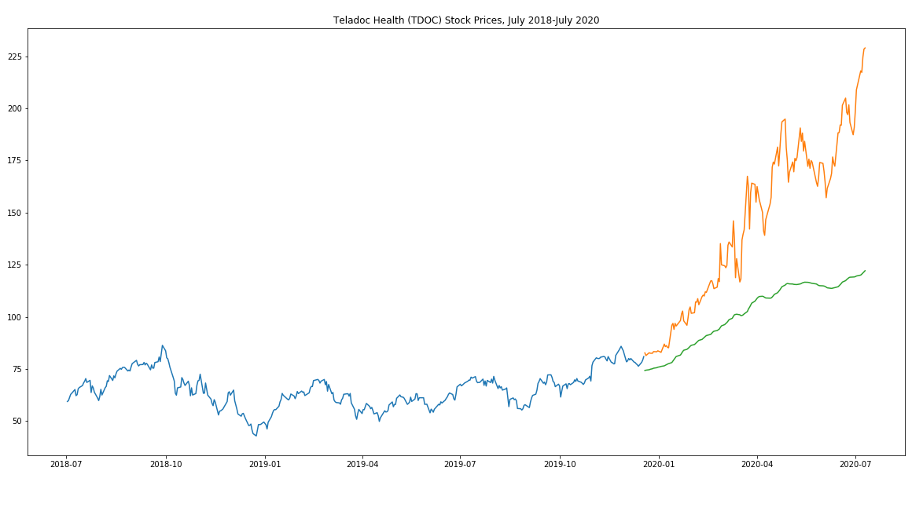

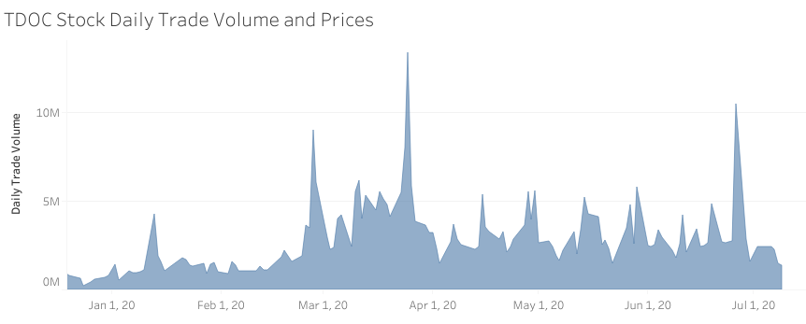
Teladoc
Actual
Predicted
Stock Price
The LSTM model is able to predict Teledoc’s rise, but it is not nearly as steep
Peak in trade volume during this time period was Mar 25, when states started issuing stay-at-home orders
Teledoc has had major growth, but this could increase competition in the industry
Despite its growth and surge in stock price, Teledoc has been in the red every year, so it may end up being an undesirable investment
Visualizing through Tableau
Notes:
https://www.fool.com/investing/2020/07/18/the-biggest-problem-with-investing-in-teladoc.aspx
Teladoc remains on the rise; on April 29, Teladoc reported year-over-year sales growth of 41%. There was also a 92% increase in visits, and memberships rose by 61%. High growth numbers like that could raise eyebrows and attract companies from other industries like the tech sector.
Tech giant Amazon and Google parent Alphabet have shown interest in the healthcare industry by partnering or investing in healthcare companies.
Why should investors care?
If a company lacks a moat, it'll likely need to compete on price. That should be a big concern for Teladoc investors, given that the company's been in the red every year. With more competition, its sales growth could taper off quickly, and the company may need to invest more in generating revenue. That means that not only would its top line slow down, but its expenses would accelerate, leading to a net negative impact on the bottom line that could put Teladoc even deeper in the red.
And without strong sales numbers, investors will be left looking at profits -- which could quickly make Teladoc an undesirable investment to hold.

Slide 8
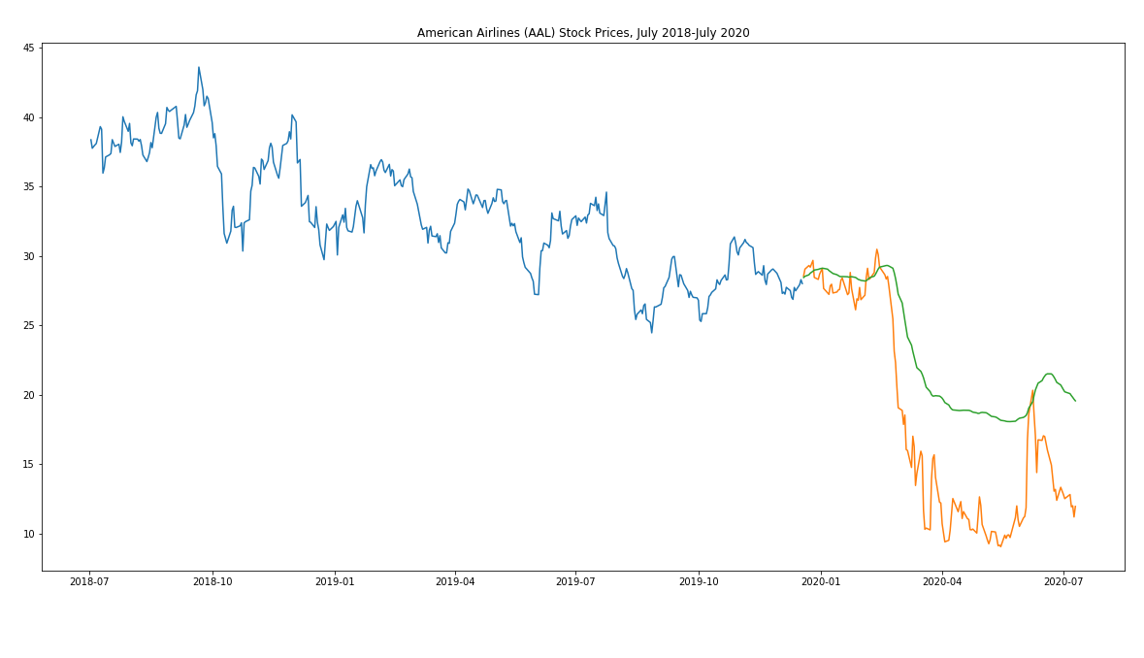

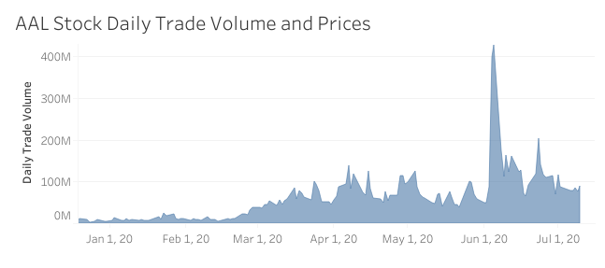
American Airlines
Actual
Predicted
Stock Price
The model was able to partially predict the sharp decline in price
Daily trade volume increased significantly in correlation to the start of the pandemic
Travel industry stocks in general were hit very hard and are still held down by uncertainty

Slide 9
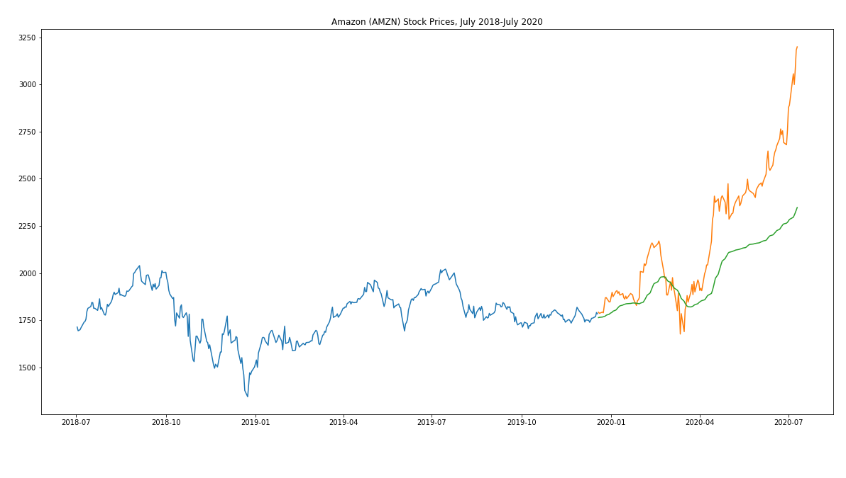

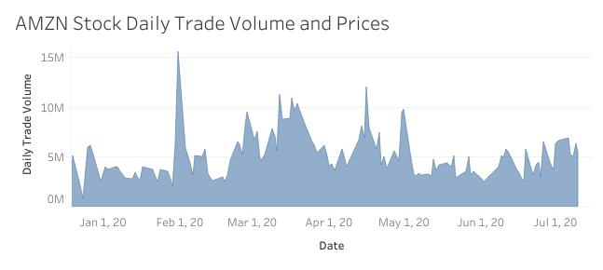
Amazon
Actual
Predicted
Stock Price
The LSTM model is able to predict Amazon’s rise, but it is not nearly as steep
It also misses some of the volatility in February
Anecdotally, e-commerce sites in general like China’s Alibaba and JD.com have been seeing similar rises, but not nearly on the scale of Amazon

Slide 10
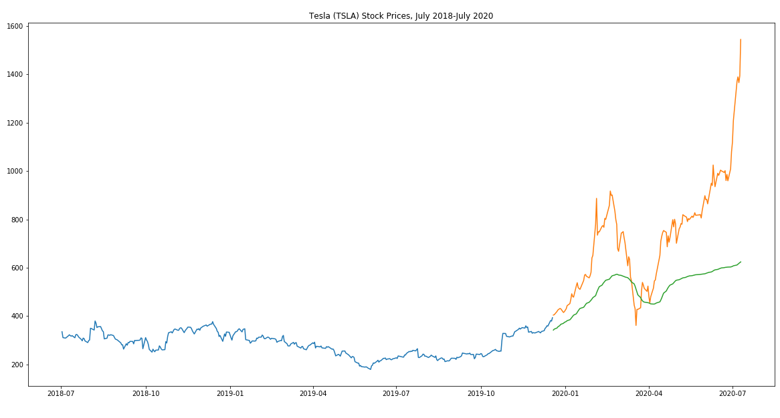

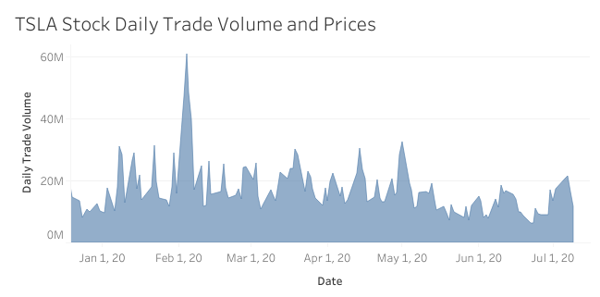
Tesla
Actual
Predicted
Stock Price
LSTM model predicts slight increases but fails to capture how drastic the increases really are
Pandemic expected to lull auto industry but ended up spiking the EV industry
Robinhood – no-fee trading app
TSLA shares have risen ~286% this year

Slide 11
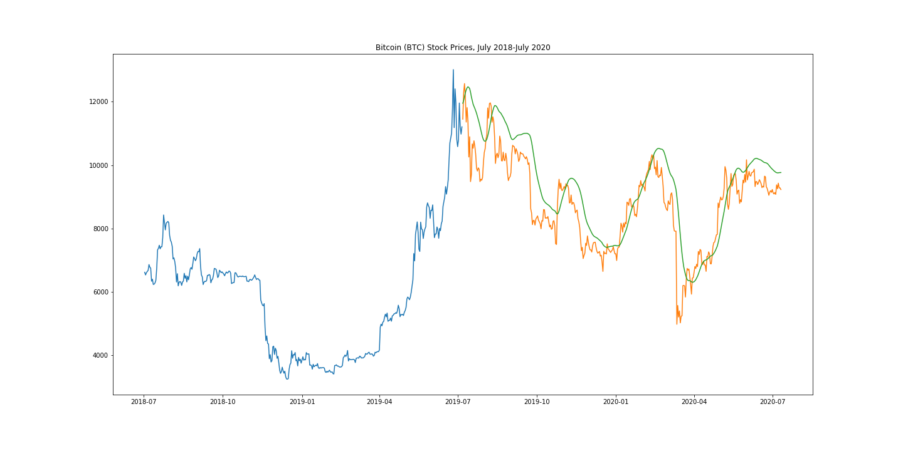
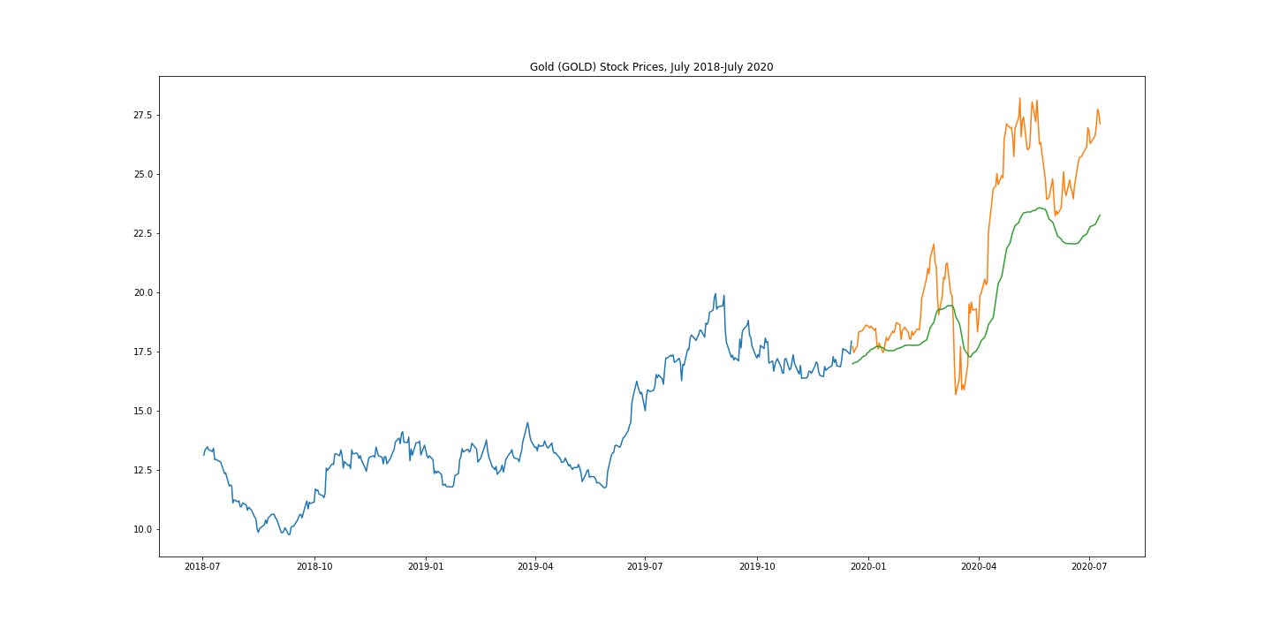
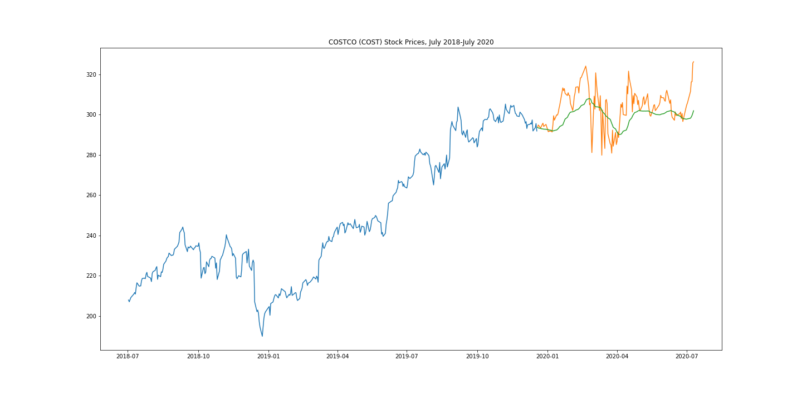
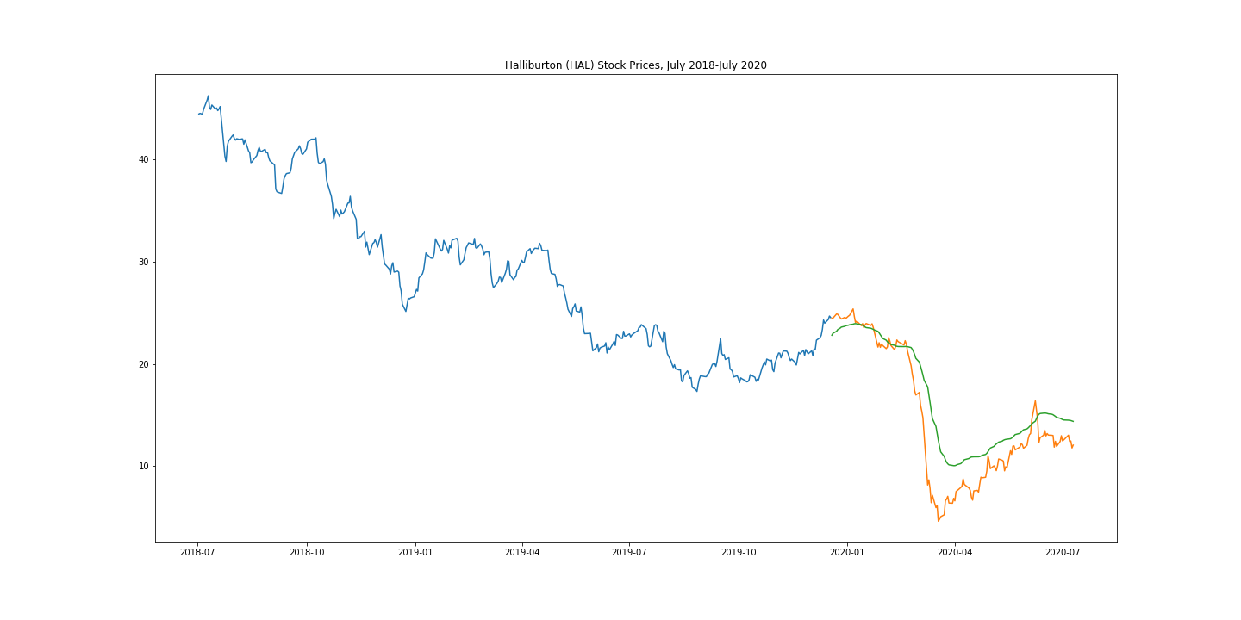
The model more closely followed other investments despite volatility
Actual
Actual
Predicted
Predicted
Stock Price
Stock Price
Actual
Actual
Predicted
Predicted
Stock Price
Stock Price

Slide 12

Summary
Unable to get a total prediction using this model without it using existing data
Would like to predict stocks from just before Covid through July “what would have happened”
But also use the model to predict current data given the market crash out through at least the fall.

Slide 13
Questions?

